Slide 1
Slowly Changing Dimensions
Submitted By
Maimoona Khilji

Slide 2
Content
Slowly changing dimensions (scd)
Types of scd
How to implement scd solution
Change data capture (cdc)

Slide 3
Slowly changing dimensions (SCD)
A slowly changing dimension in data management and data warehousing is a dimension which contains relatively static data which can change slowly but unpredictably, rather than according to a regular schedule.
A Slowly Changing Dimension (SCD) is a dimension that stores and manages both current and historical data over time in a data warehouse.
It is considered and implemented as one of the most critical ETL tasks in tracking the history of dimension records.

Slide 4
Types of SCD
Type of SCD | Description
Type 0 | Ignore any changes and audit the changes.
Type 1 | Overwrite the changes
Type 2 | History will be added as a new row.
Type 3 | History will be added as a new column.
Type 4 | A new dimension will be added
Type 6 | Combination of Type 2 and Type 3

Slide 5
Type 0 SCD - Ignore any changes and audit the changes
There are situations where you ignore any changes.
For example, when an employee joined an organization, there are joined related attributes such as joined Designation and JoinedDate, etc. that should not change over time.

Slide 6
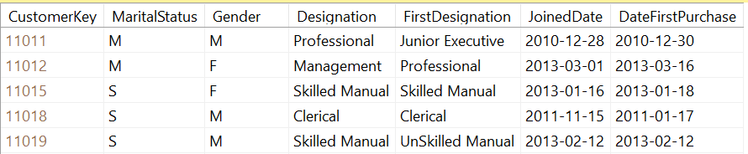
Type 0 SCD - Ignore any changes and audit the changes
The following is the example for Type 0 of Slowly Changing Dimensions in Data Warehouse. In the below Customer table : Dimension, FirstDesignation, JoinedDate and DateFirstPurchase are the attributes that will not be updated which is Type 0 SCD.

Slide 7
Type 1 SCD - Overwriting
In a Type 1 SCD the new data overwrites the existing data.
Thus the existing data is lost as it is not stored anywhere else.
This is the default type of dimension you create.
You do not need to specify any additional information to create a Type 1 SCD.

Slide 8
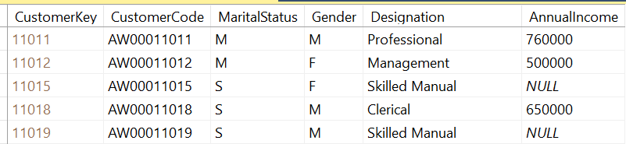
Type 1 SCD - Overwriting
Type 1 SCDs are identifying if the existing attributes are null and you are receiving a value from the operational table.
In the above Customer Dimension table, the AnnualIncome of customers CustomerKey 11015 and 11019 are NULL. When these records are updated in the operational database, those values should be updated in the data warehouse without considering those are historical values.

Slide 9
Type 2 SCD – Creating another dimension record
A Type 2 SCD retains the full history of values.
When the value of a chosen attribute changes, the current record is closed.
A new record is created with the changed data values and this new record becomes the current record.
Each record contains the effective time and expiration time to identify the time period between which the record was active.

Slide 10
Type 3 SCD - Creating a current value field
A Type 3 SCD stores two versions of values for certain selected level attributes.
Each record stores the previous value and the current value of the selected attribute.
When the value of any of the selected attributes changes, the current value is stored as the old value and the new value becomes the current value.

Slide 11


Type 3 SCD - Creating a current value field
Consider the below table:
Here, we add a new column called “Previous Country” to track what the last value for our attribute was. Note how this will only provide a single historical value for Country. If the customer changes his name, we will not be able to track it without adding a new column. Likewise, if Bob moved country again, we would either need to add further “Previous Country” columns or lose the fact that he once lived in the United Kingdom.

Slide 12
Type 4 SCD – History Table
Show current value in dimension table but track all changes in separate table
Depending on the requirements, you may place both ID and Surrogate Key onto the fact record so that you can optimize performance whilst maintaining functionality.
Separating the historical data makes your dimensions smaller and therefore reduces complexity and improves performance if the majority of uses only need the current value.
However, if you do require historical values, this structure adds complexity and data redundancy overheads. It is generally assumed that the system will use Type 1 or Type 2 rather than Type 4.

Slide 13


Type 4 SCD – History Table
There is no change to our existing table here, we simply update the record as if a Type 1 change had occurred. However, we simultaneously maintain a history table to keep track of these changes.

Slide 14
Type 6 – Hybrid SCD
Utilize techniques from SCD Types 1, 2 and 3 to track change
The ‘Hybrid method simply takes SCD types 1, 2 and 3 and applies all techniques. We would maintain a history of all changes whilst simultaneously updating a “current value” column on all records.

Slide 15

Type 6 – Hybrid SCD
This gives you the ability to provide an element of change comparison without additional calculation, whilst still maintaining a full, detailed history of all changes in the system.
Personally, if this requirement came up, I would avoid the data redundancy of this extra column and simply calculate the current value using the “LAST_VALUE()” window function at run-time. Although this depends on your priorities between data storage and direct querying performance.

Slide 16
Change data capture (CDC)
Change data capture (CDC) refers to the process of identifying and capturing changes made to data in a database and then delivering those changes in real-time to a downstream process or system.
Change data capture is a method of ETL (Extract, Transform, Load) where data is extracted from a source, transformed, and then loaded to a target repository such as a data lake or data warehouse.

Slide 17
Change Data Capture in ETL - Extract
Extract
Historically, data would be extracted in bulk using batch-based database queries. The challenge comes as data in the source tables is continuously updated. Completely refreshing a replica of the source data is not suitable and therefore these updates are not reliably reflected in the target repository.
Change data capture solves for this challenge, extracting data in a real-time or near-real-time manner and providing you a reliable stream of change data.

Slide 18
Change Data Capture in ETL - Transform
Transformation
Typically, ETL tools transform data in a staging area before loading. This involves converting a data set’s structure and format to match the target repository, typically a traditional data warehouse. Given the constraints of these warehouses, the entire data set must be transformed before loading, so transforming large data sets can be time intensive.
Today’s datasets are too large and timeliness is too important for this approach. In the more modern ELT pipeline (Extract, Load, Transform), data is loaded immediately and then transformed in the target system, typically a cloud-based data warehouse, data lake, or data lakehouse. ELT operates either on a micro-batch timescale, only loading the data modified since the last successful load, or CDC timescale which continually loads data as it changes at the source.

Slide 19
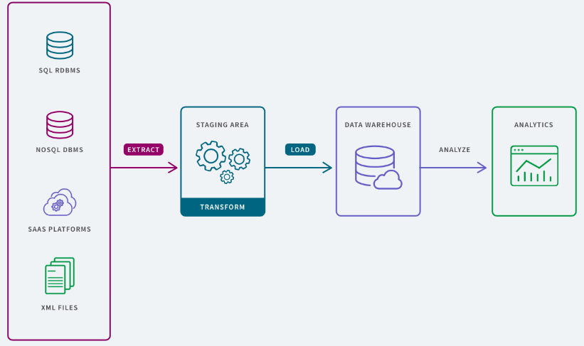
Change Data Capture in ETL - Load
Load
This phase refers to the process of placing the data into the target system, where it can be analyzed by BI or analytics tools.

Slide 20
THE END

